Slide 1
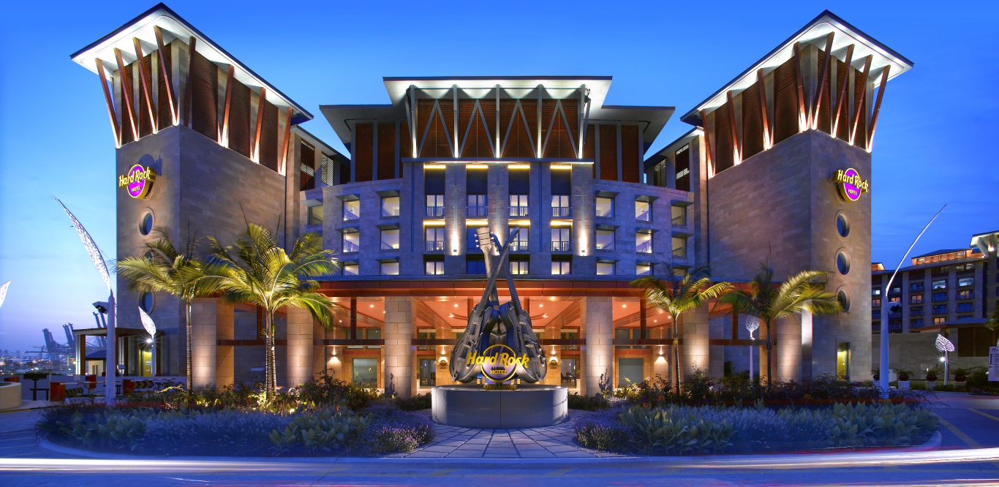
Hotel Management System
Project by:
Syeda Saba (15C31A0584)
Veera Swamy (16C35A0515)
Pavani (16C35A0505)
Ahmedullah (15C31A0583)
Under The Guidance of: Mr.Devender
Asst professor

Slide 2
ABSTRACT
In our project on “Hotel Management System”, we have tried to show how the Date / Information in hotel is managed.
This is just an overview of management in hotels.
This has been achieved by dividing the project into various modules. Customer is provided with different services like checking in ,checking out and editing entries or can be advance payment etc.

Slide 3
If the customer wants he can cancel his booking. Enquiry about any customer or employee can be made either by customer id or customer name. Enquiry about rooms available can also be made.
Our project also include the module for employee information will generate reports for customer, employee and Bill for customer is generated when the customer will check out form hotel.
We have included only few modules ,as our purpose is to only have the idea or to study about how management us done in hotels.

Slide 4
EXISTING SYSTEM
Present days we are using computarized online system for booking hotels. This system reduce the human work by avoiding the manual system .
The system is on online although there have a lot of problems which Damages customer satisfaction .
They manage on their information but they dint focus on the customer and the customer needs.
They dint care about the customer needs and third party agents are included

Slide 5
DISADVANTAGES OF EXISTING SYSTEM
Problems in finding hotels.
Not friendly approach
Problem to manage huge data and to process the necessary report and document.
Improper communication with the hotels
Not available for every user due to the heavy cost
Third party agents are involved

Slide 6
PROPOSED SYSTEM
We are proposing online hotel management system which can avoid the disadvantages in the existing system with the updated features which mainly focus on the customer satisfaction
which supports direct communication with the customers without any third party
Refund is available with some limits this satisfies customers
Every facility is handled by the hotel management only without any private agents.

Slide 7
ADVANTAGES OF PROPOSED SYSTEM
Text messenger which helps in communicating with site .
Complaint box.
Providing information about the hotel information like chefs information.
Root mapping.
Cab facilities for customer up to some limit
Number of offers on room booking
Legal information of hotels
Online payments.

Slide 8
SOFTWARE REQUIREMENTS
Client-side scripting : PHP
Backend database : MYSQL
Web Presentation : CSS/HTML
Build Tool : Bootstrap
Operating System : Windows

Slide 9
HARDWARE REQUIREMENTS
Hard Disk(min) : 1MB
RAM(min) : 256MB
Processor : 2.0GHZ

Slide 10
BIBILOGRAPHY
https://www.consumeraffairs.com/travel/hotelsdotcom.html
https://in.hotels.com/
https://www.makemytrip.com/hotels/
https://blog.capterra.com/the-5-most-popular-hotel-management-software-solutions-for-small-hotels-compared/
https://www.gourmetmarketing.net/top-6-problems-hotel-managers-face/

Slide 11
CONCLUSION
It has been a matter of immense pleasure, honor and challenge to have this opportunity to take up this project .
With this we supports customers to have their facilities and more over supporting poor customers to enjoy the hotel life
Where there is our project there is a customer satisfaction
Which supports all facilities to make poor customers as rich customers

Slide 12


